Slide 1
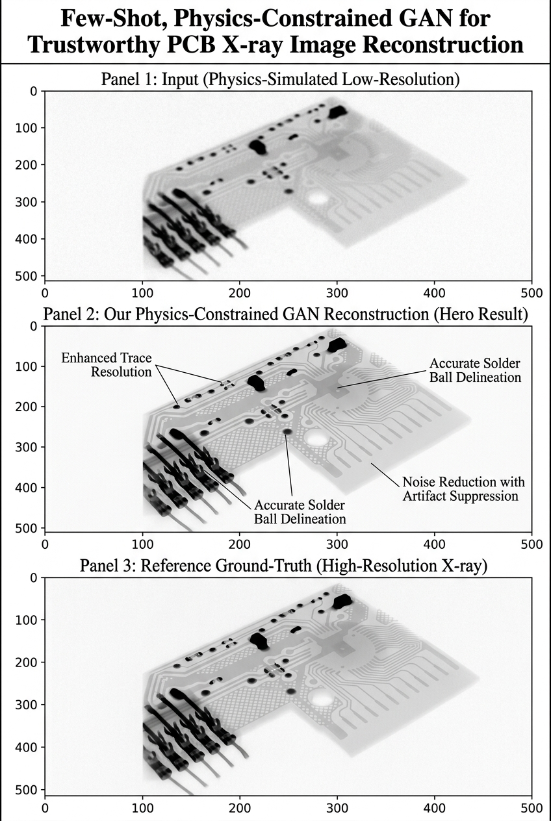
XrayTrust
Few-Shot, Physics-Constrained GAN for Trustworthy PCB X-ray Image Reconstruction
A data-efficient, ground-truth-independent reconstruction and quality-monitoring framework for AI-assisted PCB inspection.
LR PCB X-ray
GAN Reconstruction
Physics Consistency
Quality Signal
Designed for Data-scarce Industrial X-ray imaging and future AI-assisted inspection.
Imon Hossain Final-Year B.Sc. Student, Dept. of CSE Dhaka University of Engineering & Technology (DUET) Innovation Fair Bangladesh 2026
XrayTrust — Innovation Fair Bangladesh 2026
1

Slide 2
The Problem: Reliable AI Inspection Under Data Scarcity
1
Limited industrial X-ray data
Bangladesh Opportunity
Large labelled datasets are expensive and difficult to obtain for most manufacturers.
Bangladesh Electronics /
PCB Manufacturing
2
GAN hallucination risk
Generated structures may introduce misleading, non-physical details into the image.
Emerging Electronics & PCB Manufacturing
3
No ground truth at deployment
Data & Annotation Gap
A true HR reference may not be available for every PCB during deployment.
Human inspection remains essential
Need for Data-Efficient AI
4
AI should assist inspectors, not make unsafe autonomous accept/reject decisions.
XrayTrust
Opportunity: build AI-assisted inspection infrastructure that works under limited data and needs no HR reference at deployment.
XrayTrust — Innovation Fair Bangladesh 2026
2

Slide 3
What Is New in XrayTrust?
1
2
3
Few-Shot Learning
Physics-Constrained Reconstruction
Ground-Truth-Independent Signal
Learns useful reconstruction from very limited training data across the operating range:
The generator is penalized whenever its reconstruction is not physically consistent with the observed input.
At deployment, no HR reference is available. Physics error alone drives a live quality/consistency signal.
5
10
20
40
100
200
• No HR Reference
• Physics Error
• Consistency Score
Hybrid Generator Loss
L_{total} = L_{adv} + λ₁ · L_{L1} + λ₂ · L_{physics}
L_{physics} = || D(G(LR)) − LR ||₁ — the reconstruction must down-sample back to the observed LR input.
XrayTrust — Innovation Fair Bangladesh 2026
3

Slide 4
XrayTrust Architecture
Training
Deployment
Input LR X-ray
LR X-ray
Generator (U-Net)
Generator
Reconstructed X-ray
Discriminator (CNN)
Physics Module
↓
(Downsample & Compare with LR)
Reconstructed X-ray
Adversarial Loss
Physics Loss
Physics Consistency
Combined Loss → Update Generator
reconstructed_input = Downsample(reconstruction)
physics_error = L1(reconstructed_input, input_lr)
Consistency Score
Generator: U-Net · Discriminator: CNN · Framework: PyTorch
Loss: Adversarial + L1 + Physics · Input: PCB X-ray · Few-shot training
XrayTrust — Innovation Fair Bangladesh 2026
4

Slide 5
Experimental Validation: Data Efficiency & Baseline Comparison
Performance saturates and does not improve monotonically with more shots (note the 200-shot dip) — data efficiency, not raw data volume, drives reconstruction quality.
Physics Consistency by Shot Count
Baseline Comparison
Shots | 5 | 10 | 20 | 40 | 100 | 200
Physics Error | 0.1523 | 0.0194 | 0.0277 | 0.0171 | 0.0154 | 0.0155
Consistency (%) | 0.6 | 93.3 | 87.3 | 94.9 | 96.1 | 96.1
Method | PSNR | SSIM
Bicubic | 33.70 dB | 0.8278
GAN(40shot) | 30.69 dB | 0.8400
404040
XrayTrust — Innovation Fair Bangladesh 2026
Few-shot GAN achieves higher structural fidelity (SSIM) than Bicubic.
Lower PSNR reflects a trade-off between pixel-level smoothing and realistic structure reconstruction
5

Slide 6
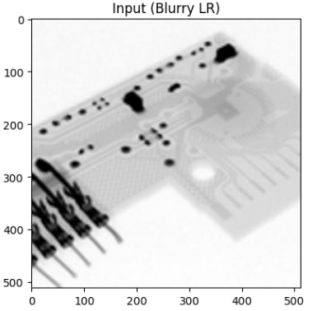

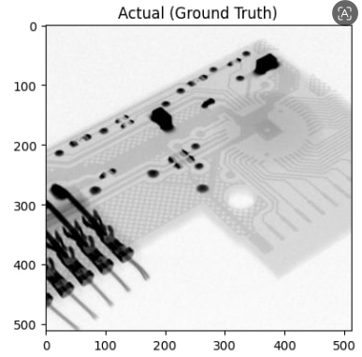
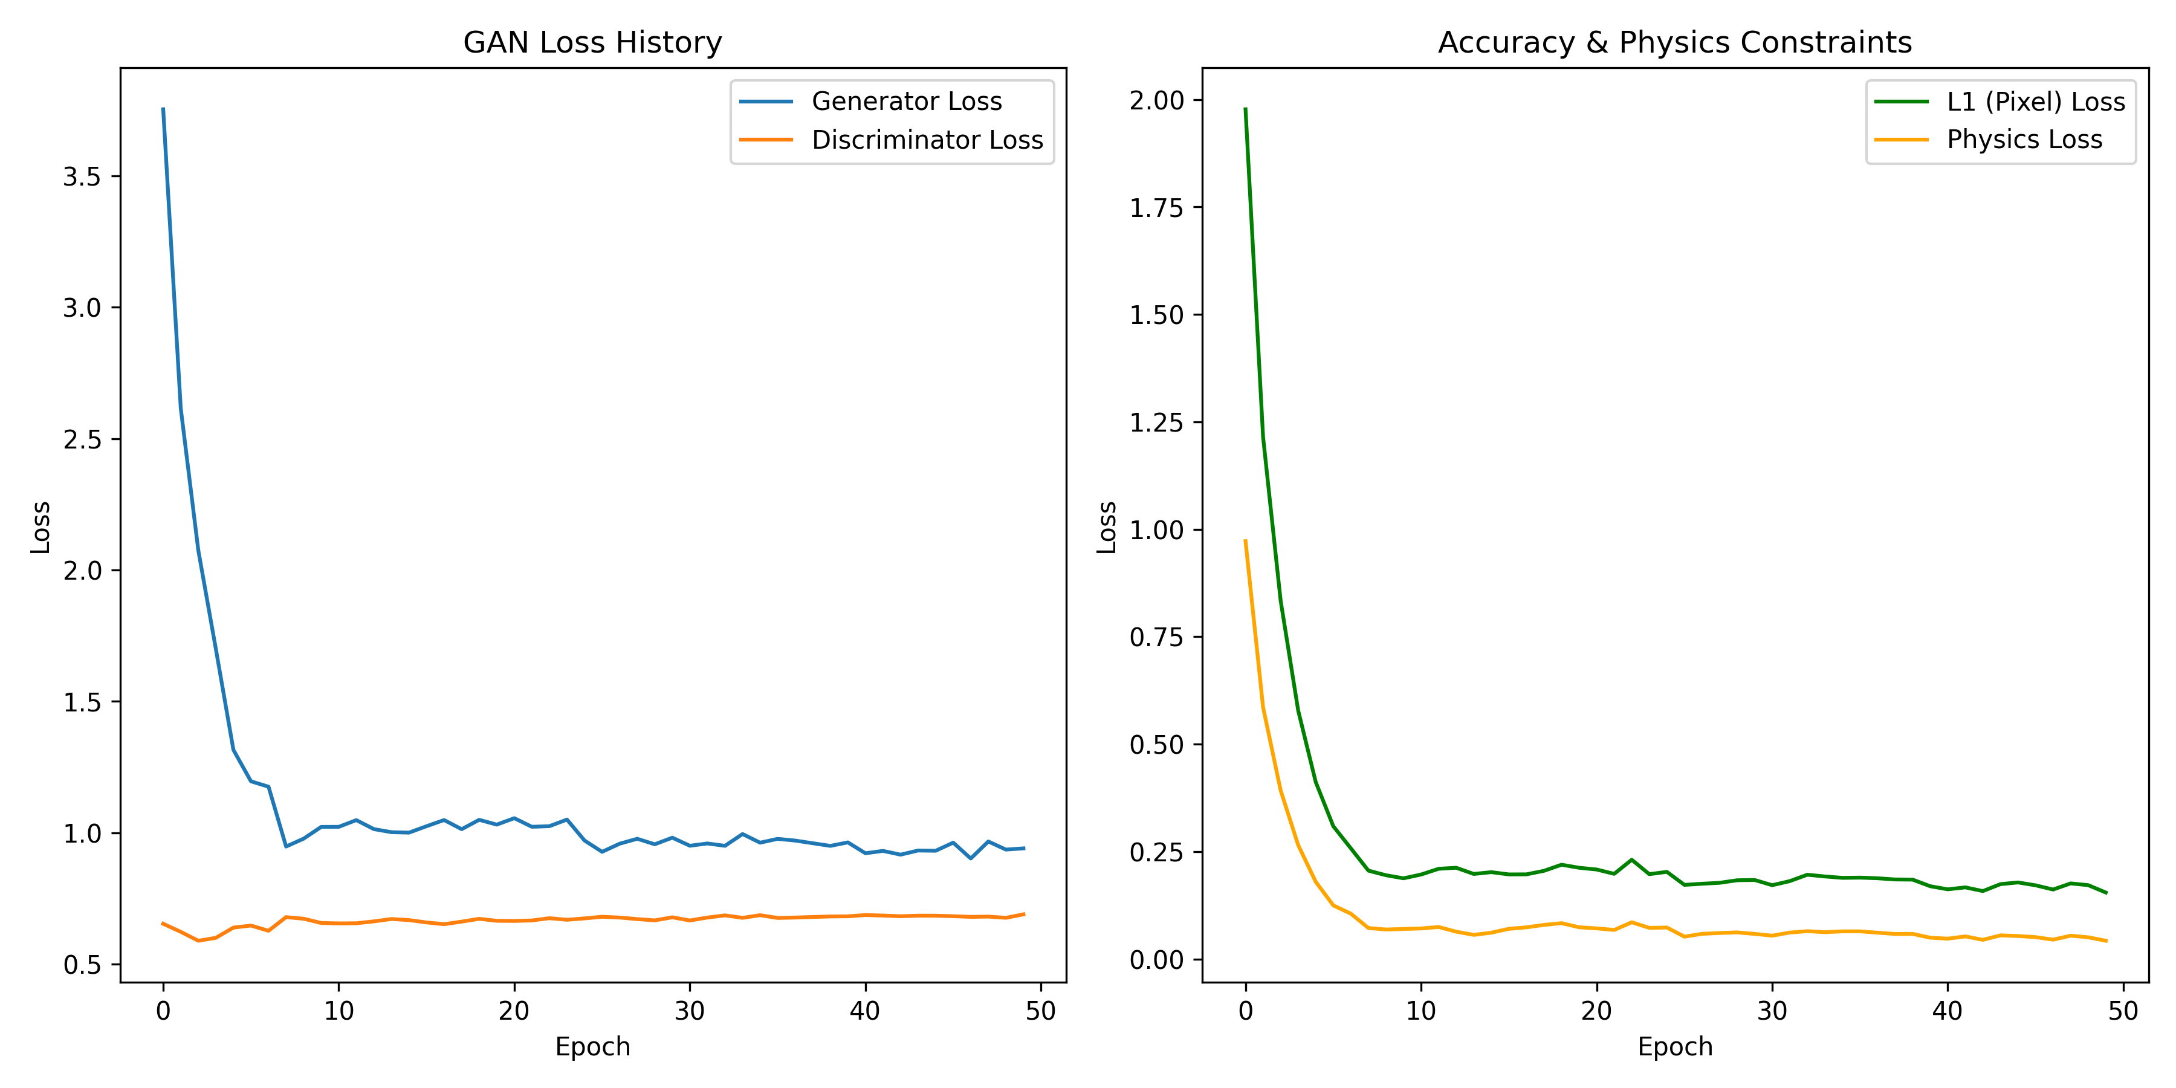
How Consistent Is the Reconstruction?
With Ground Truth Used for research validation (SSIM, PSNR, L1). Without Ground Truth Physics consistency alone provides a deployment-time reconstruction quality signal.
GAN training loss history
28.54 dB
0.9820
0.0234
0.0209
95.35%
PSNR
SSIM
L1 Error
Physics Error
Consistency
⚠ Consistency Score ≠ PCB Safety Score It measures reconstruction/physics consistency only — not defect absence, and not a PASS/FAIL decision.
XrayTrust — Innovation Fair Bangladesh 2026
6

Slide 7
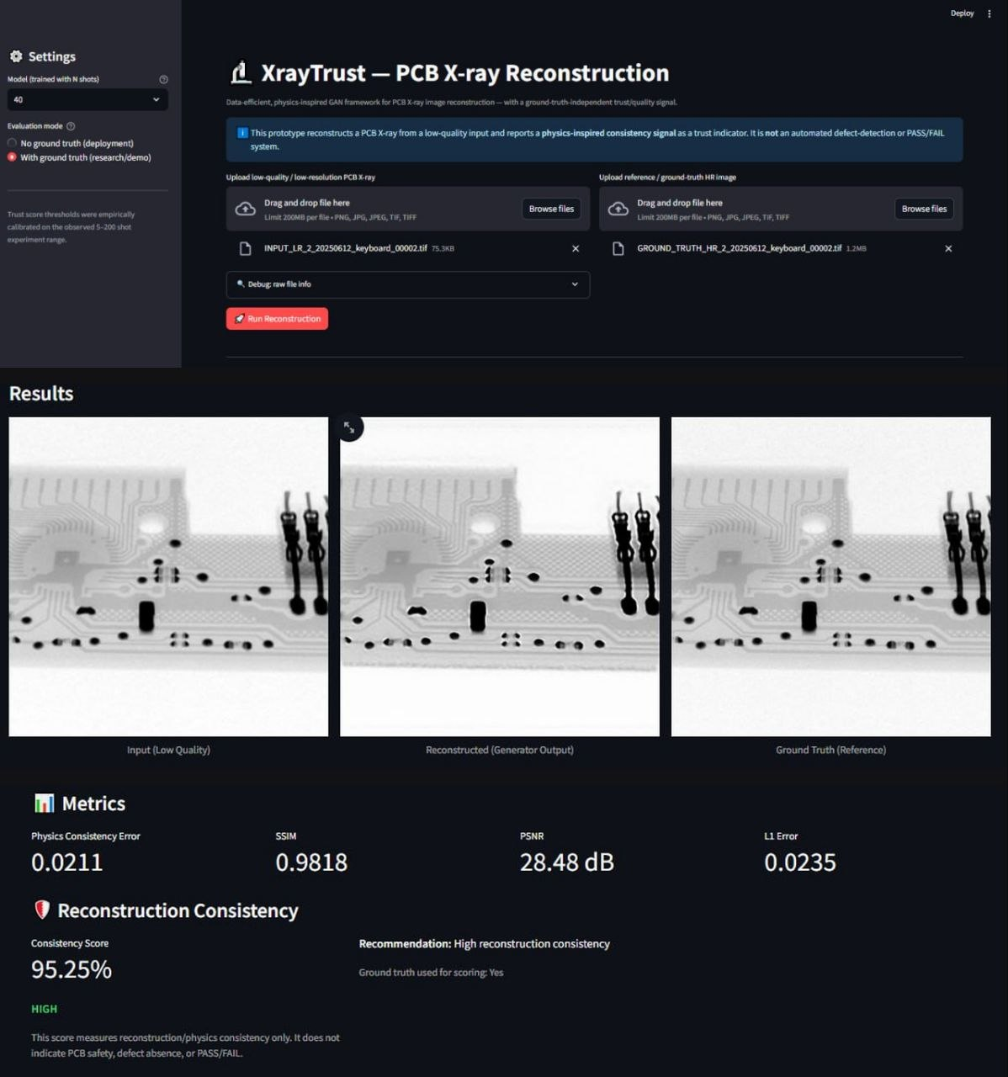
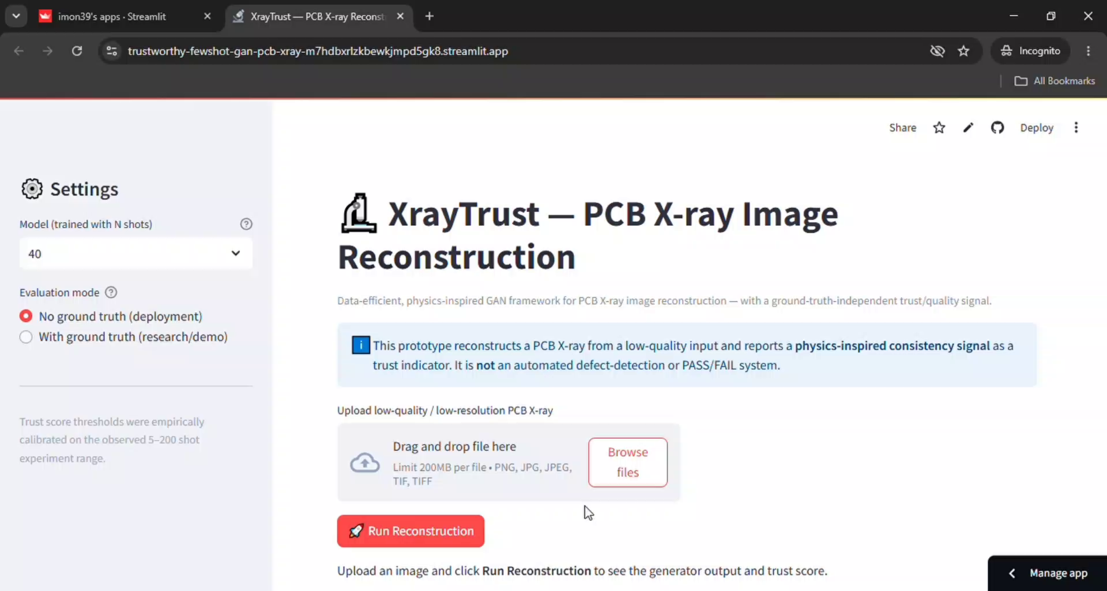
From Research Model to Industrial Prototype
Prototype Workflow
Upload X-ray
Select Model / Mode
Reconstruction
Physics Error
Consistency Score
Factory X-ray
→
XrayTrust
→
Reconstruction + Consistency
→
→
High → AI-Assisted Workflow
Low → Human Review
→
XrayTrust — Innovation Fair Bangladesh 2026
7

Slide 8
Impact, Commercialization & Future Roadmap
Industrial Impact (Current)
what X-ray does today
Commercialization Pathway(NEXT)
what can be added
Future Roadmap
Few shot X-ray reconstruction
Ground truth free deployment signal
Physics consistency monitoring
Human-in-the-loop inspection support
PCB Manufacturers
CURRENT
Few-shot reconstruction + physics consistency
PCB anomaly detection
NEXT
Defect localization
PCB anomaly detection & defect localization
Future: Semiconductor Inspection
FUTURE(Industrial Vision)
AI-assisted semiconductor inspection
AI-assisted PCB inspection
industrial NDT
Other X-ray imaging domains
Target Users / Potential Industry Partners — not existing agreements.
SDG 9 Industry, Innovation
& Infrastructure
SDG 8 Decent Work &
Economic Growth
SDG 12 Responsible
Production
Developed, trained, evaluated, and prototyped end-to-end by the applicant as an independent research and engineering effort.
XrayTrust — Innovation Fair Bangladesh 2026
8

